Slide 1

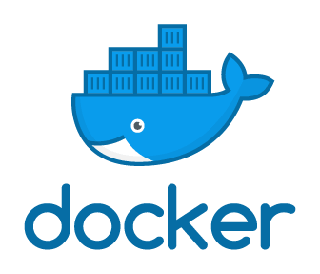
(BCSE 0510) Container Orchestration and Infrastructure Automation
Introduction to Docker
Lecture: 1

Slide 2
AGENDA
What is docker?
Software Development Life Cycle
About Software
Example
About Containers
Where does the Docker comes?

Slide 3
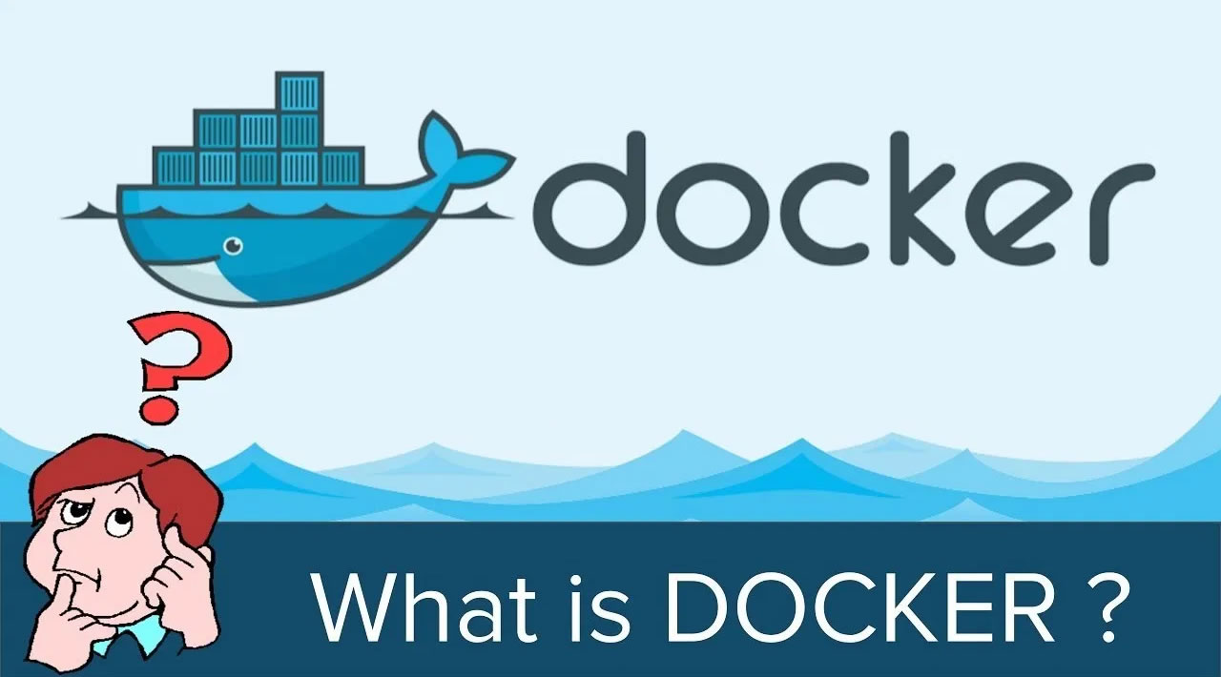

Slide 4
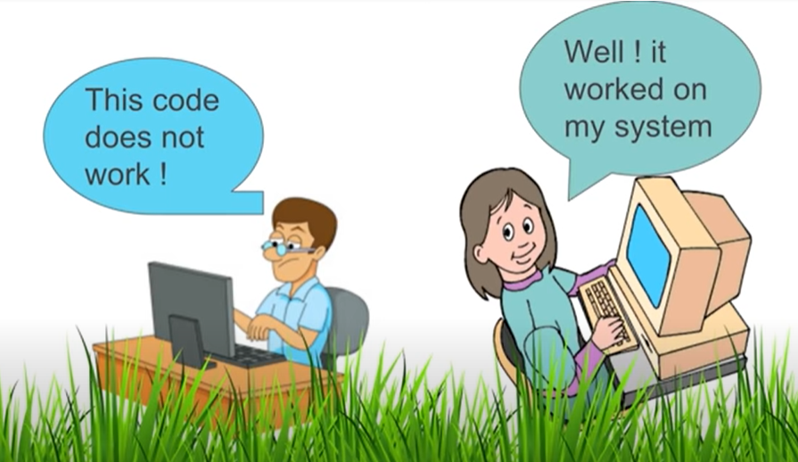
WHY DOCKER?

Slide 5
WHY DOCKER?
Have you faced this issue……?
A code works well on developer system but might be doesn’t work on another system.
Docker resolves this issue of an application working on one platform and not working on some other platform however there is much more to Docker.

Slide 6
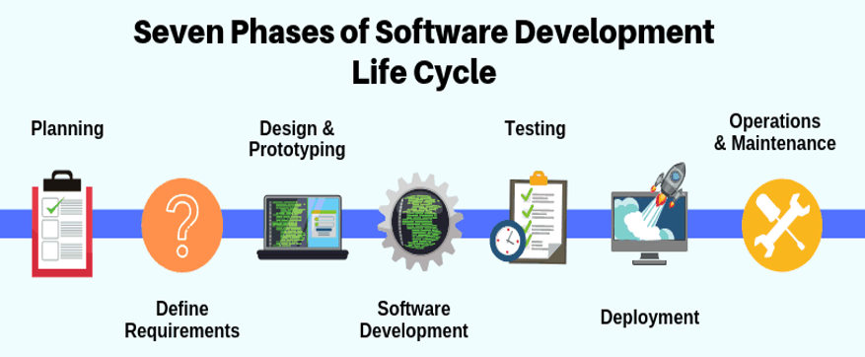
SOFTWARE DEVELOPMENT LIFE CYCLE

Slide 7
WHAT IS DOCKER?
Docker makes the process of application deployment very easy and efficient and resolves a lot of issues related to deploying applications.

Slide 8
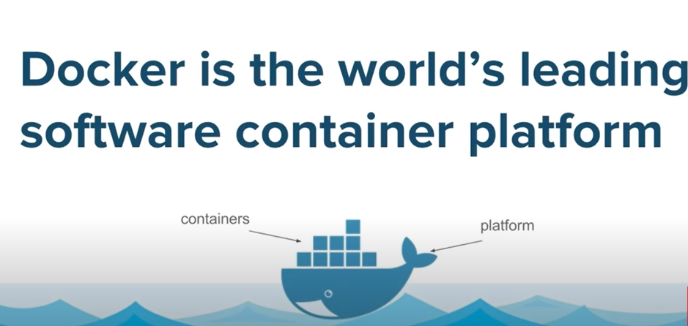
WHAT IS DOCKER? CONTD…

Slide 9
EXAMPLE
A Classical Problem in Shipping Industry
How to transport different goods having different size, shape and requirements to different locations of the world?

Slide 10
ABOUT SOFTWARE….
Software is not just a piece of code however it is an entire software stack a typical software application will consists of a group of:
Front end Components
Back end Components
Databases
Servers
Libraries
We have to ensure that all these components work on different platforms, it is very complex that each of our component work on every possible platform.

Slide 11
EXAMPLE
So you can think of all the possible ways While transporting the goods in shipping industry.
And again the situation becomes very complex so how did this solve the problem?

Slide 12
EXAMPLE
While transporting the goods you need to take care of lot of things:
Trucks to be used?
Packaging?
Expert Staff?
Shipping Medium? Etc.
Type of Product:
Some items are big
Some items are small
Some items are hard
Some items are fragile
Some items are liquid
Some have no shape

Slide 13
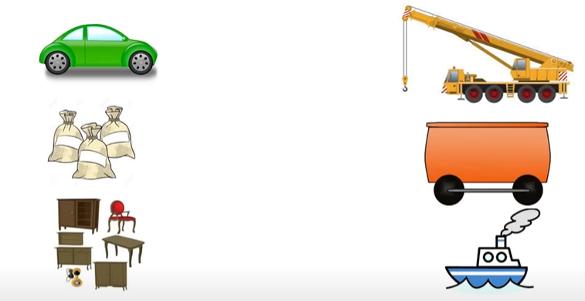
EXAMPLE

Slide 14
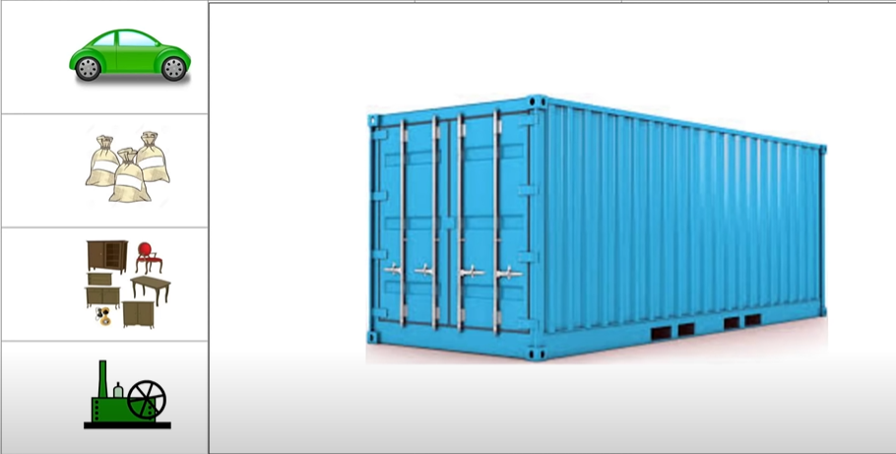
EXAMPLE

Slide 15
EXAMPLE
Solve the problem by using containers.
Containers are standard boxes where the goods can be packaged in the standard way.

Slide 16
EXAMPLE
It looks like we have a similar kind of solution and the solution is again using containers and using the standard way of shipping these containers and here comes the docker.

Slide 17
EXAMPLE
Docker is a tool designed to make it easier to deploy and run applications by using containers.
Containers allow a developer to package up an application with all of the parts it needs, such as libraries and other dependencies, and ship it all out as one package.

Slide 18
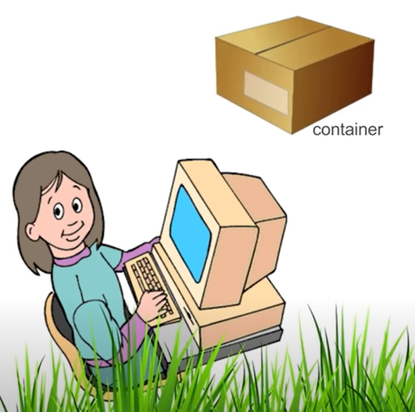
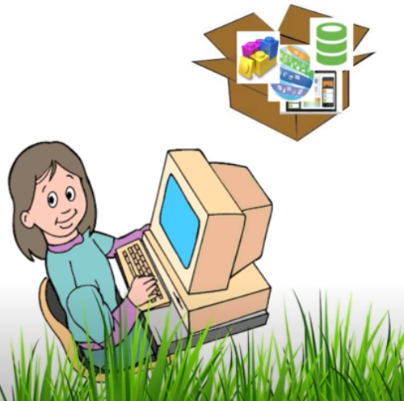
WHAT IS DOCKER?

Slide 19
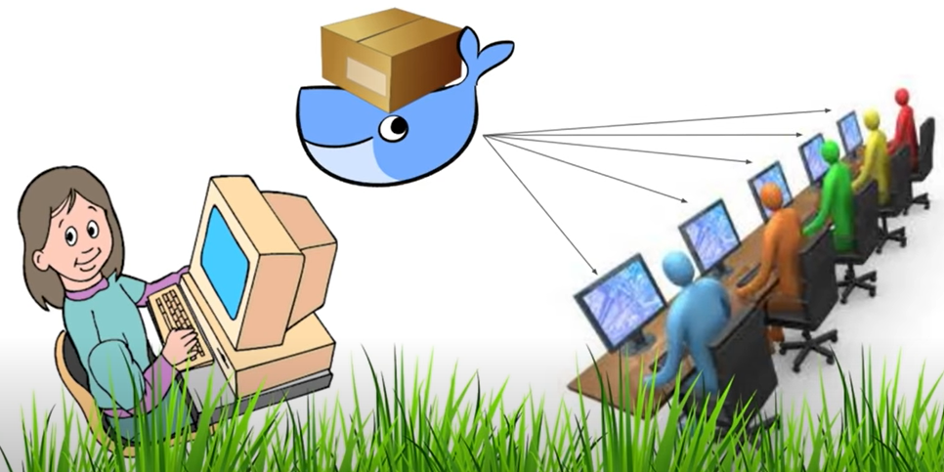
EXAMPLE

Slide 20
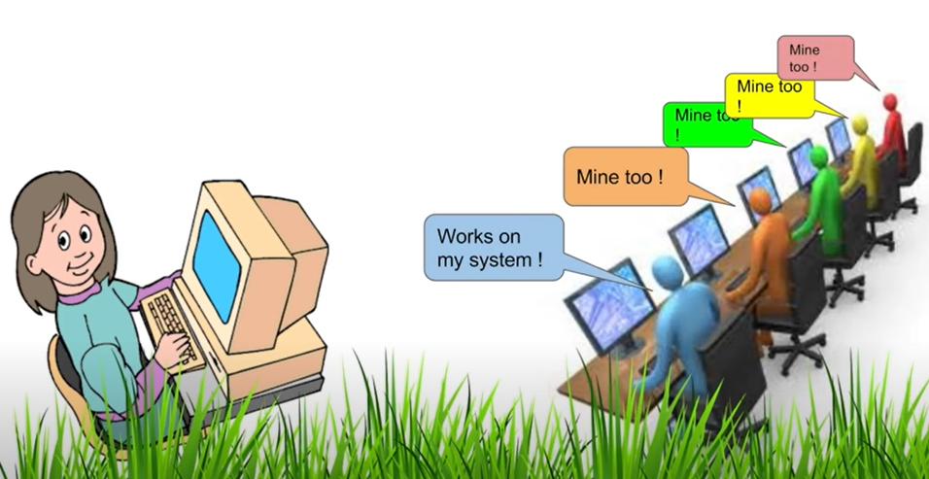
EXAMPLE

Slide 21
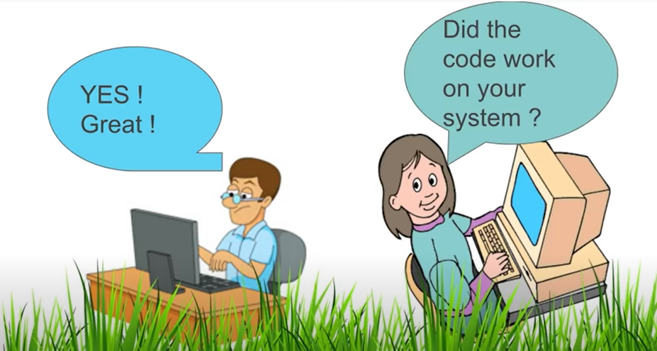
EXAMPLE

Slide 22
WHAT IS DOCKER?
Docker is an open and secure hybrid cloud platform.
Docker is a free software created by Docker Incorporated.
It enables clients to create free and confined environments to dispatch and deploy its applications.
With Docker, there are no more reliance or accumulation issues.

Slide 23
WHAT IS DOCKER?
Docker is an open source platform for building, deploying, and managing containerized applications.
It enables developers to package applications into containers standardized executable components that combine application source code with all the operating system (OS) libraries and dependencies required to run the code in any environment.

Slide 24
WHAT IS DOCKER?
A developer will now really focus on creating the code, the software and will package the software along with all its dependencies into a container.
And will not worry about how this will be deployed on what all platforms it has to be deployed?
Docker makes this process of deploying software very easy, very efficient and very good.

Slide 25
WHAT IS DOCKER?
https://www.youtube.com/watch?v=GOuVeZmMee0

Slide 26


